Slide 1

Brighton Community Center Feasibility Study
Final Report Presentation
Ballard*King & Associates
Darin Barr, President

Slide 2
Introduction
Ballard*King & Associates
Founded in 1992
1,200 projects in all 50 states
Facility Planning & Operations Consultants
Feasibility Studies, Master Plans, Operational Assessments
Brighton, Pittsford, Irondequoit, Perinton

Slide 3

Process
Assess existing & potential locations
Public input
Demographics & participation statistics
Trends
Facility recommendations
Operational plan
Debt service & household impact

Slide 4
Timeline
2019
2021
2020
Phase I Winter Market Barn site improvements begin
COVID pandemic shutdown; Town staff work remotely
RTO, limited capacity; virtual public meetings continue
Phase II Winter Market Barn site improvements begin
Town Hall HVAC deficient, lack air filtration
Phase IA Winter Market Barn interior renovations begin
Design for Phase II Winter Market Barn site improvements begins
Town issues RFP for Community Center Feasibility Study (March)
Survey for public input opens; community input is collected at Brighton Farmers Market (September)
Community input is collected at Brighton High School homecoming (October)
Community stakeholder meetings (November)
Brookside building sale to Talmudical Institute of Upstate NY (TIUNY) completed

Slide 5
Timeline
2022
2024
2025
Winter Market Shed addition construction begins
Community & Recreation Center Needs Assessment & Feasibility Study presentation to the public
Concept for Town Hall campus rec amenities including pool refurbishment, new splash pad, pavilion, & accessible playground
Town Hall renovation work begins
Presentation of the Community Center Feasibility Study final report to the public
Town acquires 44 acres adjacent to Buckland Park (per Town Open Space Acquisition & Development Plan)
Feasibility Study draft report compiled
2023
Winter Farmers Market opens in the renovated and expanded barn
Town Hall renovation design begins, incl. HVAC, ADA improvements, security & tech updates, asbestos remediation
Town Hall relocates temporarily to SUNY Empire State University
Staging begins for Town Hall renovation
Development of plan for Town Hall campus site work

Slide 6
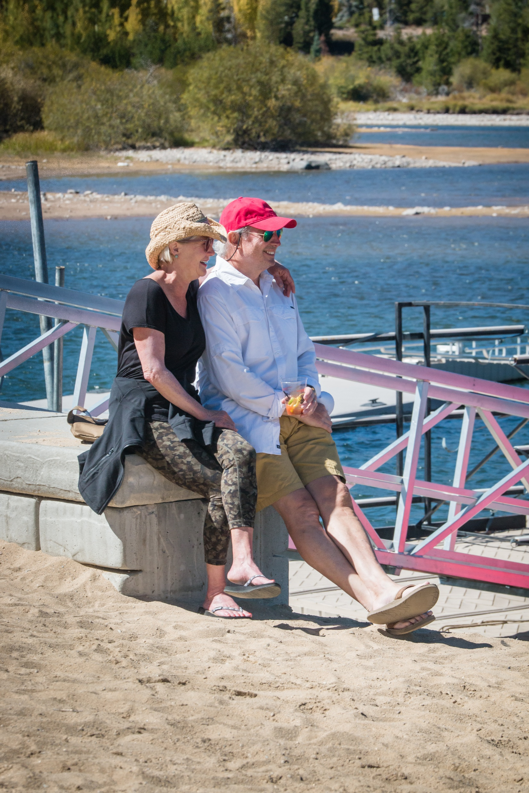
Current & Potential Locations
Brookside Current Rented Location
Temporary
Non-Town Owned Options
Jubilee Center
Jewish Community Center (JCC)
Town Owned Option
Buckland Park

Slide 7
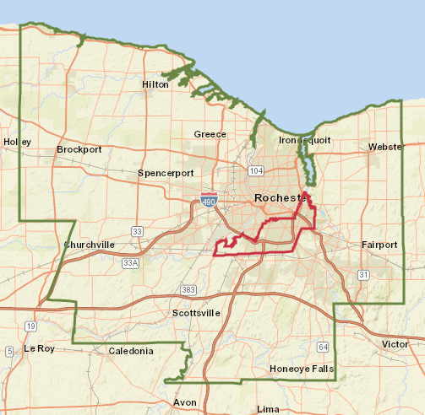
Demographics
Population
Median Age
Median Income
Cost of Living

Slide 8
Community Center v. Recreation Center
Community Center
Not membership-based
Drop-in usage
Program focused
Space available for public/community use
Recreation Center
Membership & daily fee-based access
Some programming
Limited use of space by community organizations

Slide 9
Public Input
Touch Points
Public survey
Farmer’s Market pop-up event
Brighton Homecoming
Parks & Recreation Advisory Board meeting
Stakeholder interviews
Community forums – Westside, Eastside
Public open house
Consistent Feedback
Town-owned meeting space for rental opportunities is lacking
Lack of gymnasium space
Opportunity to expand programming
Provide indoor opportunities for the long winter
Needs to be accessible from multiple modes of transportation

Slide 10

Recommendation: Serve Brighton Best
Town-owned and operated Community Center
Purpose built at Buckland Park
Approximately 40,000 total square feet

Slide 11
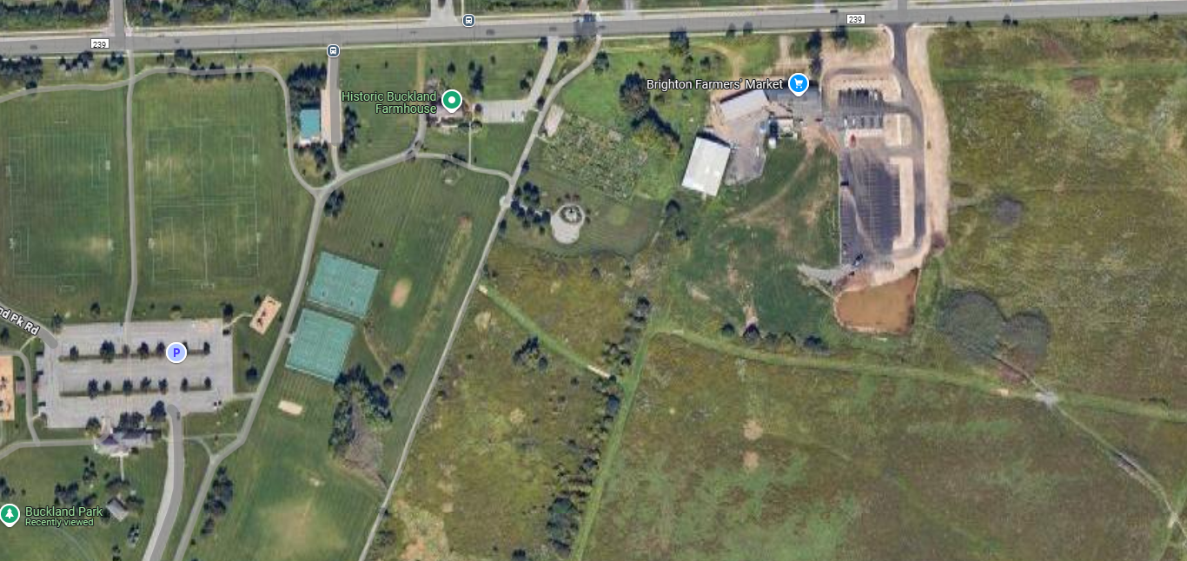
Recommended Location
Proposed Location Future Community Center
WESTFALL ROAD
BRIGHTON FARMERS MARKET
BUCKLAND PARK

Slide 12
Recommended Components
Lobby
Front desk/admin area
Large meeting room (300)
Adjacent storage
Commercial kitchen
Dedicated senior space
Studio
Storage
Meeting room #1
Meeting room #2
Indoor playground
Double gymnasium
Elevated walk/jog track
Restrooms & changing
Notes:
Necessary slide? Mostly duplicates content on slide #9.

Slide 13
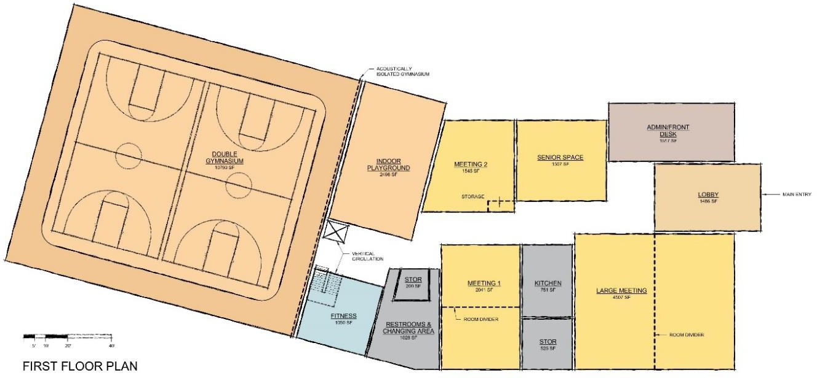
Recommended First Floor Concept

Slide 14
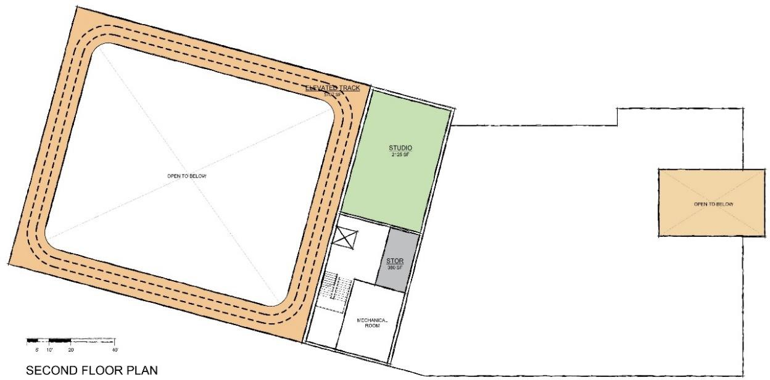
Recommended Second Floor Concept

Slide 15
Construction & Project Cost Estimates
Programmable space 33,250 sq. ft.
15% Gross-up (circulation & building) 4,933 sq. ft.
Total Building 38,238 sq. ft.
$550 / sq. ft.
Construction Cost $21,030,625
Total Project Cost $26,288,281
This cost estimate assumes no grant or other third-party financial assistance.

Slide 16
Operational Impact
New Expenses
Personnel $ 720,322
Commodities $ 28,500
Contractual $ 233,959
Internal $ 102,000
Brookside Lease ($ 235,000)
New Expenses $ 849,780
Existing budget $1,900,000
Budget w/out CIA $2,749,780
Capital improvement $ 100,000
Monday-Friday
7:00A-9:00P
Saturday
7:00A-6:00P
Sunday
12:00P-6:00P

Slide 17

Operational Impact
New programs $176,790
Vending $ 1,550
Rentals $141,500
New revenue $319,790
Existing revenue $508,000
Total revenue $827,790

Slide 18
Cost per Average Household Impact
Annual payment $2,228,318
Average Home Value $317,823
Annual Household Impact to Average Home $232.62
Monthly Household Impact $19.39

Slide 19
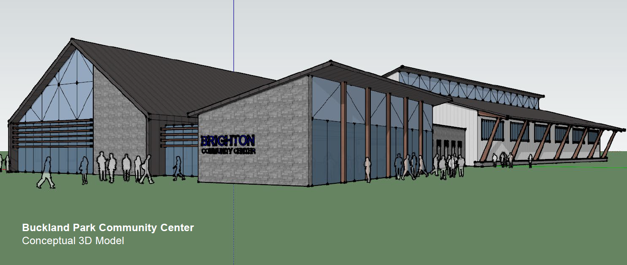
Questions
Proposed

